Slide 1



Slide 2



01CE0701 – Mobile Computing
Unit - 1
Detailed Introduction of Mobile Computing
Computer Engineering Department

Slide 3


Outline
Introduction of Mobile Computing
Security issues
Different Propagation Modes
Architecture of mobile computing
Needs of mobile user

Slide 4
Introduction
MOBILITY?.........
Notes:
Mobility is defined as the potential for movement and the ability to get from one place to another using one or more modes of transport to meet daily needs.
As such, it differs from accessibility, which refers to the ability to access or reach a desired service or activity.
Mobility is a term used in computer networking to describe the scalability and exchangeability of a device or service within a given context. It refers to being able to use existing or new technology and services with minimal additional effort or disruption.
In the context of mobile computing, this includes being able to quickly and securely switch between different types of physical wireless networks (such as WiFi, Cellular, Bluetooth, etc.), connect securely with varying service providers, and having access to cloud-based services.

Slide 5
Introduction
Computing?.........
Notes:
Computing is the process of using computer technology to complete a given goal-oriented tasks
Computing is the act of calculating something
The use and operation of computers………..

Slide 6
Mobile computing-Introduction
What is Mobile Computing?
Mobile Computing is a technology that allows transmission of data, voice and video via a computer or any other wireless enabled device without having to be connected to a fixed physical link.

Slide 7
Mobile computing-Introduction
Mobile computing can be defined as a computing environment of physical mobility.
The user of a mobile computing environment will be able to access data, information, or other logical objects from any device in any network while on the move.
A mobile computing system allows a user to perform a task from anywhere using a computing device in the public (the Web), corporate (business information) and personal information spaces (medical record, address book).
Notes:
To make the mobile computing environment ubiquitous, it is necessary that the co communication bearer is spread over both wired and wireless media. Be it for the mobile workforce, holidayers, enterprises, or rural population, access to information and virtual objects through mobile computing is absolutely necessary for optimal use of resource and increased productivity

Slide 8
Mobile computing-Introduction
Understanding the Term “Mobile computing” More …
Mobile computing is used in different contexts with different names.
Mobile Computing: This computing environment moves along with the user. This is similar to the telephone number of a GSM (Global System for Mobile communication) phone, which moves with the phone. The offline (local) and real-time (remote) computing environment will move with the user. In real-time mode the user will be able to use all his remote data and services online.
Anywhere, Anytime Information: This is the generic definition of ubiquity, where the information is available anywhere, all the time.
Virtual Home Environment: Virtual Home Environment (VHE) is defined as an environment in a foreign network such that the mobile users can experience the same computing experience as they have in their home or corporate computing environment.

Slide 9
Understanding the Term “Mobile computing” More …
Mobile computing is used in different contexts with different names.
Nomadic Computing: The computing environment is nomadic and moves along with the mobile user. This is true for both local and remote services.
Pervasive Computing: A computing environment, which is pervasive in nature and can be made available in any environment
Ubiquitous Computing: A (nobody will notice its presence) everyplace computing environment. The user will be able to use both local and remote services
Global Service Portability: Making a service portable and available in every environment. Any service of any environment will be available globally.
Wearable Computers: Wearable computers can be worn by humans like a hat, shoe or clothes (these are wearable accessories).
Notes:
Wearable computers need to have some additional attributes compared to standard mobile devices. Wearable computers are always on; operational while on the move; hands-free, context-aware (with different types of sensors). Wearable computers need to be equipped with proactive attention and notifications. The ultimate wearable computers will have sensors implanted in the body and supposedly integrate with the human nervous system. These are part of a new discipline of research categorized by “Cyborg” (Cyber Organism).

Slide 10
Introduction
Types of Mobile computing
Mobile computing
Fixed & Wired
Fixed & Wireless
Mobile & Wired
Mobile & Wireless
Fixed & Wired: Devices are fixed at a position, and they are connected through a physical link to communicate with other devices. Ex., Desktop
Fixed & Wireless: Devices are fixed at a position, and they are connected through a wireless link to make communication with other devices. Ex., Wi-Fi Router, communication tower
Mobile & Wired: Some devices are wired, and some are mobile. They altogether make communication with other devices.. Ex., Laptops
Mobile & Wireless: Devices can communicate with each other irrespective of their position. They can also connect to any network without the use of any wired device.. Ex., Mobile

Slide 11
Introduction
Benefits of Mobile Computing
Easy to carry and work from anywhere
Saves Time
Voice and data transmission
Enhanced Productivity
Ease of Research
Wireless LAN to access Internet from anywhere
Attractive user interface

Slide 12
Introduction
Application of Mobile Computing
Web or Internet access
Email
Global Position System (GPS)
Emergency services
Entertainment services
Educational services
Online Transactions

Slide 13
Introduction
Limitations of Mobile Computing
Network Fluctuation
Battery consumption
Bandwidth
Small screen sizes
Issues of interoperability
Security

Slide 14
Introduction
Application of Mobile Computing
Web or Internet access
Email
Global Position System (GPS)
Emergency services
Entertainment services
Educational services
Online Transactions

Slide 15

Security Concern regarding Mobile Computing

Slide 16
Security Concern regarding Mobile Computing
Security Issues in mobile computing
General Security Issues
Wireless Security Issues
Device Security Issues

Slide 17
Security Concern regarding Mobile Computing
General Security Issues
Confidentiality:
This is used to prevent unauthorized users from gaining access to any particular user's critical and confidential information.
Integrity:
This is used to ensure that any type of unauthorized modification, destruction or creation of information cannot be done.
Availability:
The availability is used to ensure that authorized users get the required access whenever they need it.
Legitimate:
This is used to ensure that only authorized, and legitimate users have access to the services.

Slide 18
Security Concern regarding Mobile Computing
Wireless Security Issues
Denial of Services:
attacker sends a large amount of unnecessary data or connection requests to the communication server. It causes a slow network, and therefore the users cannot get benefitted from using its service.
Traffic Analysis:
Monitor communication between users. In this process, the service provider listens the traffic flowing in the wireless channel to access the private information of users affected by the attacker.
Eavesdropping:
Attacker can log on to the wireless network and access sensitive data if the wireless network was not secure enough. This can also be done if the information is not encrypted.
Session Interception and Modification of Message:
It specifies that the attacker can intercept the session and modify the transmitted data in this session. This scenario is called "man in the middle." It inserts the attacker's host between the sender and receiver host.
Spoofing:
Attacker impersonates him as an authorized account of another user and tries to access the sensitive data and unauthorized services.

Slide 19
Security Concern regarding Mobile Computing
Device Security Issues
Push Attacks:
In the push attack, the attacker creates a malicious code at the user's mobile device by hacking it and then he/she may spread it to affect other elements of the network.
Pull Attacks:
The pull attack is a type of attack where the attacker controls the device and handles it in his/her way. He can decide which emails they want to receive. In this attack, the user can decide about the obtained data by the device itself.
Forced De-authentication:
In this security issue, the attackers convince the mobile end-point or the mobile user to drop its connection and re-connection to get a new signal. Within this process, they insert their device between the mobile device and the network and steal the information or do the fraud.

Slide 20
Security Concern regarding Mobile Computing
How to handle security issues?
Hire qualified personnel.
Install security hardware and software.
Data should be in encrypted form.
Educate the users on proper mobile computing ethics and security issues.
Use antivirus software in mobile devices.
Firewall client should be installed on mobile devices.
Make your mobile devices encrypted with a strong password.
Encrypt your data stored in the secondary storage devices such as Memory Sticks, Data card, removable USB etc. (Back up your mobile device)
Ensure that the Bluetooth, Wi-Fi, etc. enabled mobile devices are turned off when you are not using them.
Make periodic backups of your mobile devices on a data server.

Slide 21
Different Propagation Modes
How Wireless Communication Occurs?
Radio Frequency Range

Slide 22
How Wireless Communication Occurs?
Wireless communication generally works through electromagnetic signals that are broadcast by an enabled device within the air, physical environment or atmosphere.
The sending device can be a sender or an intermediate device with the ability to propagate wireless signals.
The communication between two devices occurs when the destination or receiving intermediate device captures these signals, creating a wireless communication bridge between the sender and receiver device.

Slide 23
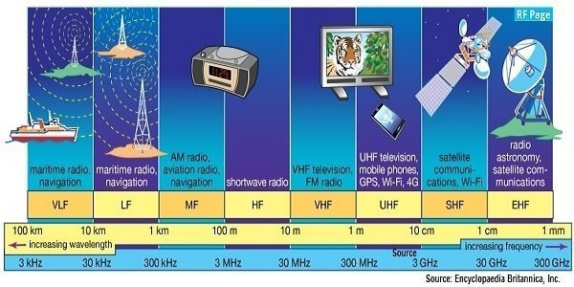
Radio Frequency bands and its uses

Slide 24
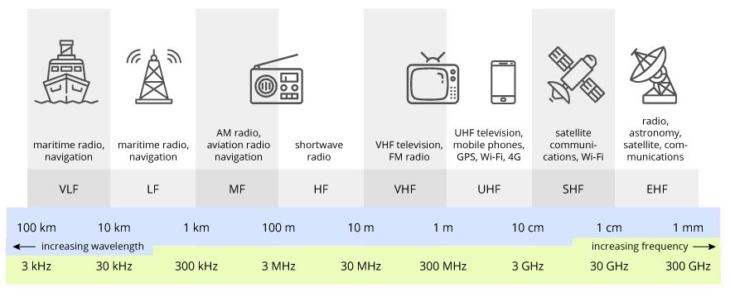
General Frequency Ranges
VLF | Very Low Frequency | VHF | Very High Frequency
LF | Low Frequency | UHF | Ultra High Frequency
MF | Medium Frequency | SHF | Super High Frequency
HF | High Frequency | EHF | Extremely High Frequency
Frequency and wavelength are
inversely proportional to each other.

Slide 25
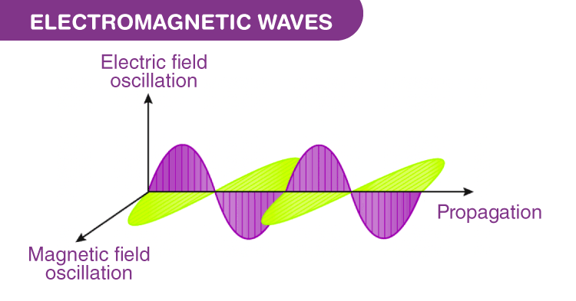
Different Propagation Modes
What is propagation?
Propagation: The radiated power propagates in space in the form of electromagnetic waves.
The radiation and propagation of the radio waves cannot be seen.
There are 3 types of propagation
Ground-wave propagation
Sky-wave propagation
Line-of-sight propagation

Slide 26
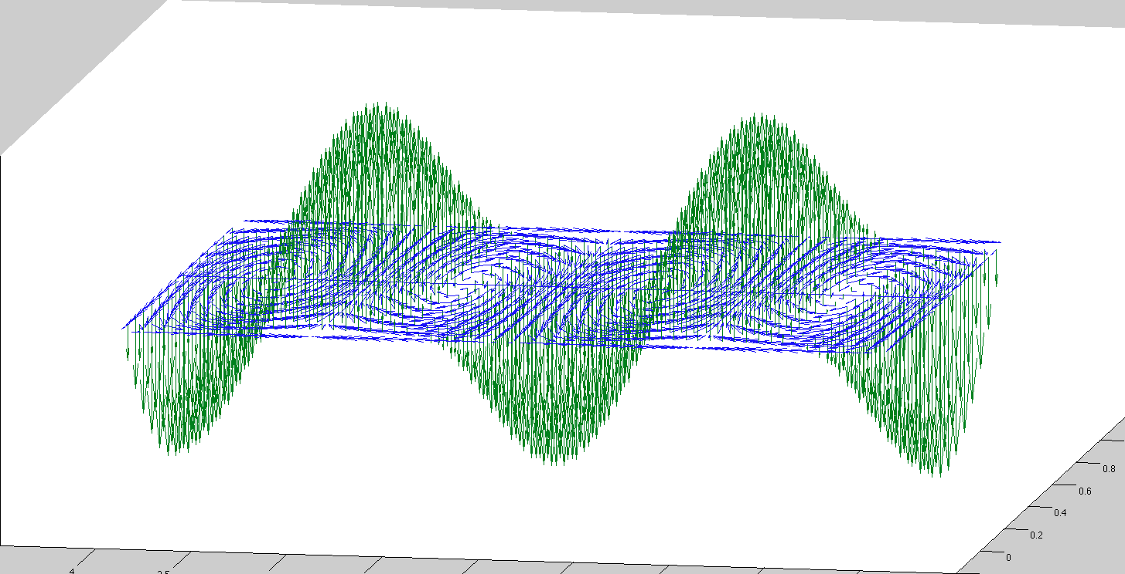
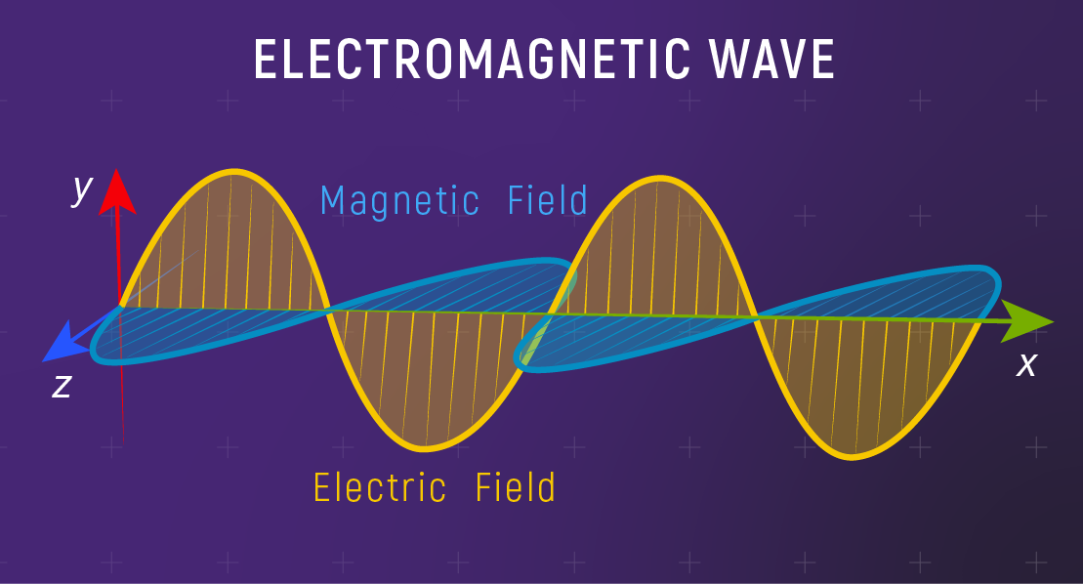
Different Propagation Modes
What is propagation?
Propagation: The radiated power propagates in space in the form of electromagnetic waves.
The radiation and propagation of the radio waves cannot be seen.
There are 3 types of propagation
Ground-wave propagation
Sky-wave propagation
Line-of-sight propagation

Slide 27
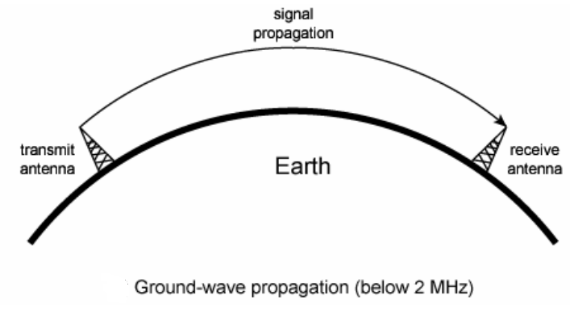
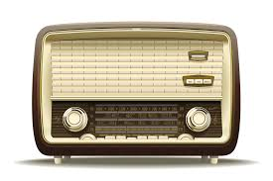
Ground Wave Propagation
The EM waves leaves antenna and remains close to the earth surface.
It follows the curvature of the earth surface and uses lower frequency.
The ground wave propagation is strongest at low and medium frequency ranges i.e. between 30kHz and 3MHz.
While passing over the earth surface, the ground waves induce some current in to it. Thus they loose some energy due to absorption.
Due to diffraction EM wave tilt over the surface of the earth and this angle increases with distance and frequency so, ground wave propagation should be used up to MW (Medium Wave) frequency band.
E.g. AM FM Radio, TV broadcasting.
Notes:
Diffraction- the process by which a beam of light or other system of waves is spread out as a result of passing through a narrow aperture or across an edge, typically accompanied by interference between the wave forms produced.

Slide 28
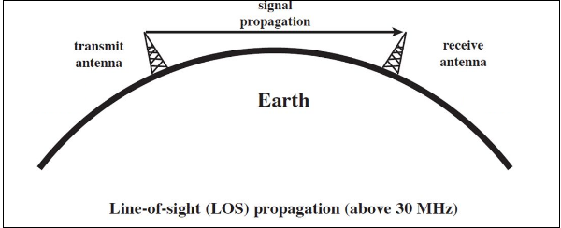
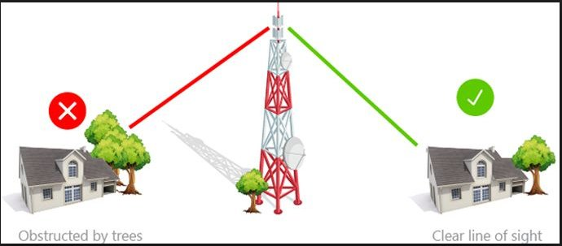
Line-of Sight Wave Propagation -Short distance
As the name implies, the wave travels a minimum distance of sight.
Ground communication - Antennas within effective line of site due to refraction.
Satellite communication - Signal above 30 MHz is not reflected by ionosphere.
Therefore it can be transmitted between an earth station and satellite.
We need to employ an amplifier/transmitter to amplify the signal and transmit again.
Application
Infrared transmission
Microwave transmission

Slide 29
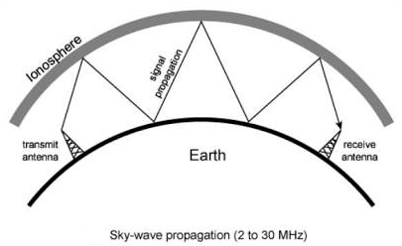
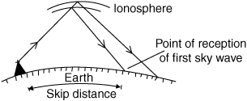
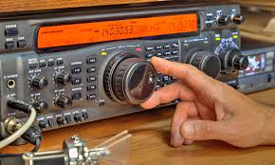
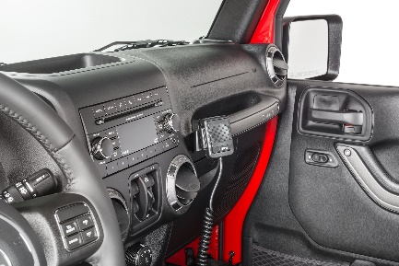
Sky Wave Propagation- Long distance communication
Signal reflected from ionized layer of atmosphere back down to earth.
Signal can travel a number of hops, back and forth between ionosphere and earth’s surface.
Ionosphere is the ionized layer around the Earth’s atmosphere, which is suitable for sky wave propagation.
Reflection effect caused by refraction.
With this propa­gation mode, a signal can be picked up thousands of kilometers from the transmitter.
Examples
Amateur radio (Ham radio)
CB radio (Citizen Band Radio)
Notes:
Refraction- the fact or phenomenon of light, radio waves, etc. being deflected in passing obliquely through the interface between one medium and another or through a medium of varying density.

Slide 30
Architecture of Mobile Computing

Slide 31
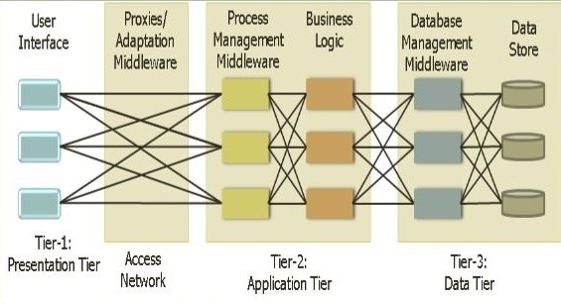
Wireless Architecture
Each tier is distributed to a different place or places in a network. These tiers do not necessarily correspond to physical locations on various computers on a network, but rather to logical layers of the application.
Presentation Layer (UI):
This layer presents data to the user and optionally permits data manipulation and data entry, also this layer requests the data form Business layer.
This layer accomplished through use of Dynamic HTML and client-side data sources and data cursors.

Slide 32
Wireless Architecture
Application Layer (AL):
The business logic acts as the server for client requests from workstations. It acts according Business rules fetch or insert data through the Data Layer.
In turn, it determines what data is needed (and where it is located) and acts as a client in relation to a third tier of programming that might be located on a local or mainframe computer.
Because these middle-tier components are not tied to a specific client, they can be used by all applications and can be moved to different locations, as response time and other rules require.

Slide 33
Wireless Architecture
Data Access Layer (DA):
The third tier of the 3-tier system is made up of the DBMS that provides all the data for the above two layers.
This is the actual DBMS access layer.
Avoiding dependencies on the storage mechanisms allows for updates or changes without the application tier clients being affected by or even aware of the change.

Slide 34
Needs of Mobile User

Slide 35
Needs of Mobile User
Seamless connectivity for better Quality of Service
Portability with devices and networks
Interactivity with different users with different types of devices
Individuality for making user identifiable among number of users
Security with respect to data as well as communication
Easier Human interface for making it’s usage user friendly

Slide 36


